Slide 1
Mathematics (9-1) - iGCSE
2018-20
Year 09
Builders need to use right angles. The Pharaohs employed harpedonapts (rope-knotters), who used a looped rope with 12 equally spaced knots. Did they seriously think they could use a looped rope to make a right angle? Clue: An Egyptian is thought to have taught a Greek who announced a famous theorem...
Unit 13 – More Trigonometry

Slide 2
Contents
Page iv
13 More trigonometry 399
Prior knowledge check 399
13.1 Accuracy 400
13.2 Graph of the sine function 402
13.3 Graph of the cosine function 405
13.4 The tangent function 408
13.5 Calculating areas and the sine rule 411
13.6 The cosine rule and 2D trigonometric problems 415
13.7 Solving problems in 3D 418
13.8 Transforming trigonometric graphs 1 421
13.9 Transforming trigonometric graphs 2 Problem-solving: Muddy tracks 423
Check up 429
Strengthen 433
Extend 435
Knowledge check Unit test 437

Slide 3
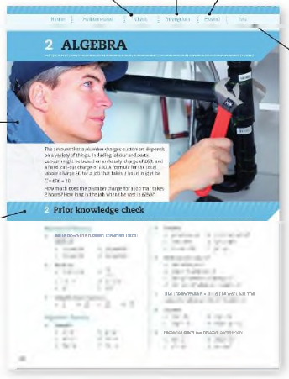
Contents
Page v
At the end of the Master lessons, take a check-up test to help you to decide whether to strengthen or Extend our learning
Extend helps you to apply the maths you know to some different situations
Unit Openers put the maths you are about to learn into a real-life context. Have a go at the question - it uses maths you have already learnt so you should be able to answer it at the start of the unit.
When you have finished the whole unit, a Unit test helps you see how much progress you are making.
Choose only the topics in strengthen thay you need a bit more practice with. You’ll find more hints here to lead you through specific questions. Then move on to Extend
Use the Prior knowledge check to make sure you are ready to start the main lessons in the unit. It checks your knowledge from Key Stage 3 and from earlier in the GCSE course. Your teacher has access to worksheets if you need to recap anything.

Slide 4
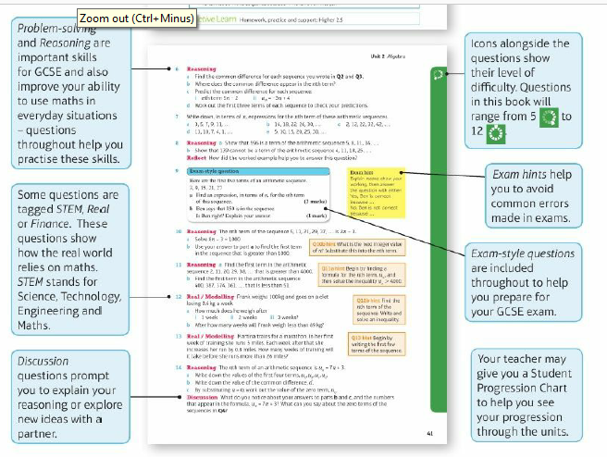
Contents
Page vi

Slide 5
13 – Prior Knowledge Check
Page 399
Numerical fluency
Work out
$\frac{0.75}{2}$ x 4
3² + 4² - 2 x 3 x 4 x 0.8
Algebraic fluency
152 = q² + 7² Find the value of q to 3 significant figures.
$\frac{x}{0.5}$ = $\frac{8.42}{0.749}$ Find the value of x to 3 significant figures.

Slide 6
13 – Prior Knowledge Check
Page 399
a = 4 b = 6.5 angle C = 58° Find the value of ab sin C. Give your answer correct to 3 significant figures.
cos $θ$ = $\frac{182 +122 − 242}{2 x 18 x 12 }$ Find the value of $θ$ correct to 1 decimal place.

Slide 7
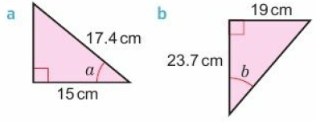
13 – Prior Knowledge Check
Page 399
Geometrical fluency
Find the exact value of x in each triangle.
Work out the size of each lettered angle. Give each answer correct to 2 decimal place.

Slide 8
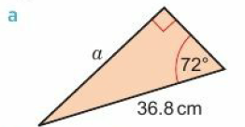
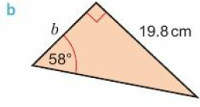
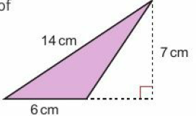
13 – Prior Knowledge Check
Page 399
Work out the size of each lettered angle. Give each answer correct to 3 decimal place.
Find the area of this triangle.

Slide 9
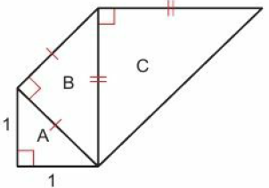
13 – Prior Knowledge Check
Page 400
Graphical fluency
a. Copy and complete the table for y = x² – 6x.
Draw the graph of y = x² - 6x for 0 ≤ x ≤ 6.
Use your graph to solve the equation x² – 6x = -5.
* Challenge
The diagram shows a sequence of isosceles right-angled triangles A, B, C, ... Continue the sequence and find the length of the hypotenuse of triangle H.
x | 0 | 1 | 2 | 3 | 4 | 5 | 6
y

Slide 10
13.1 – Accuracy
Page 400
Objectives |  | Did You Know?
Understand and use upper and lower bounds in calculations involving trigonometry. |  | The caesium fountain atomic clock at the National Physical Laboratory in the UK is the most accurate in the world. In 138 million years it is unlikely to be a second out.
Fluency
The height of a book is measured as 15.4 cm to 1 decimal place. What are the upper and lower bounds of the height of the book?
ActiveLearn - Homework, practice and support: Higher 13.1

Slide 11
13.1 – Accuracy
Page 400
y = 3.6 to 1 d.p. z = 9.2 to 1 d.p. x = yz
Find the upper bound and the lower bound of y.
Find the upper bound and the lower bound of z.
Work out the value of the upper bound of x.
Work out the value of the lower bound of x.
Q1c hint - Which bounds of y and z give the largest possible value for yz?

Slide 12
13.1 – Accuracy
Page 400
y = 1.2 to 1 d.p. z = 0.4 to 1 d.p. x = $\frac{y}{z}$
Find the upper bound and the lower bound of y.
Find the upper bound and the lower bound of z.
Work out the value of the upper bound of x,
Work out the value of the lower bound of x.
Q2c hint - Check all possible calculations to make sure you have the highest possible value for $\frac{y}{z}$

Slide 13
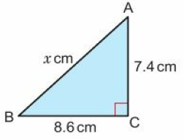
13.1 – Accuracy
Page 400
In the diagram, the lengths of AC and BC are given correct to 1 d.p.
Find the upper bound for the length of i. AC ii. BC
Use your answers to part a to work out the upper bound of x.
Find the lower bound for the length of i. AC ii. BC
Use your answers to part c to work out the lower bound of x.

Slide 14
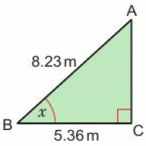
13.1 – Accuracy
Page 401
Example 1
In this diagram, the measurements are correct to 3 significant figures,
Find the upper and lower bounds for the value oft, to 3 decimal places,
Give the value of x to a suitable level of accuracy.
AB: upper bound = 8.235m, lower bound = 8.225 m BC: upper bound = 5.305 m, lower bound = 5.355 m The upper bound for cos x = $\frac{\text{5.365}}{\text{8.225}}$= 0.6522796353 So x = 49.286° (3 d.p.) The lower bound for cos x = $\frac{\text{5.3}\text{5}\text{5}}{\text{8.2}\text{3}\text{5}}$ So x = 49.438° (3 d.p.) So The upper bound for x is 49.438° and the lower bound is 49.286°
49.438° = 49.4 (1 d.p.) 49.286° = 49.3 (1 d.p.) = 49⁰ (nearest degree) x = 49⁰ (to the nearest degree)
Find the upper and lower bounds of the lengths of AB and BC.
The upper bound of a fraction = $\frac{\text{upper} \text{bound} \text{of} \text{the} \text{numerator}}{\text{lower} \text{bound} \text{of} \text{the} \text{denominator}}$ Write down all the figures in your calculator display.
Use cos⁻¹ on your calculator
The lower bound of a fraction = $\frac{\text{lower} \text{bound} \text{of} \text{the} \text{numerator}}{\text{upper} \text{bound} \text{of} \text{the} \text{denominator}}$
You could write the answer in 49.286⁰ ≤ x < 49.438⁰
Round to the nearest degree they both give the same value.
Round the upper and lower bounds to 1 d.p. Do they both give the same value?

Slide 15
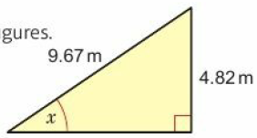
13.1 – Accuracy
Page 401
The upper bound for cost is 0.7322834646 and the lower bound is 0.7054263565.
Find the upper and lower bounds for x, to 3 decimal places,
What do you notice?
Discussion Why does this happen? Will it also happen with sine and tangent?
In this diagram, the measurements are correct to 3 significant figures,
Find the upper and lower bounds for the value of x, to 3 decimal places.
Write x to a suitable level of accuracy.
Q4b hint – Does the upper bound for cos x give the upper bound for x?

Slide 16
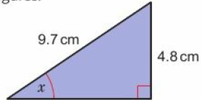
13.1 – Accuracy
Page 401
In this diagram, the measurements are correct to 2 significant figures.
Find the upper and lower bounds for the value oft, to 3 decimal places.
Write x to a suitable level of accuracy.
Discussion Compare your answers with those for Q5. How have the upper and lower bounds fort been affected by reducing the accuracy of the measurements to 2 significant figures?

Slide 17
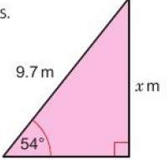
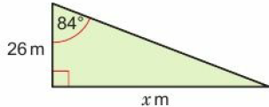
13.1 – Accuracy
Page 402
In this diagram, the measurements are correct to 2 significant figures Find the upper and lower bounds for the value of x. In this diagram, the measurements are correct to 2 significant figures. Find the upper and lower bounds for the value of x.
Discussion Compare your answers with those for Q7. Why is the level of accuracy worse in this question?

Slide 18
13.1 – Accuracy
Page 402
9 – Exam-Style Questions
Dan does an experiment to find the value of π. He measures the circumference and the diameter of a circle.
He measures the circumference, C, as 170 mm to the nearest millimetre.
He measures the diameter, d, as 54 mm to the nearest millimetre.
Dan uses π = $\frac{C}{d}$ to find the value of π.
Calculate the upper bound and the lower bound for Dan’s value of it. (4 marks)
June 2013, Q23, 1MA0/2H
Q9 strategy hint – The upper bound of $\frac{C}{d}$ is not $\frac{\text{upper} \text{bound} \text{of} \text{C}}{\text{upper} \text{bound} \text{of} \text{d}}$and the lower bound of $\frac{\text{C}}{\text{d}}$ is not $\frac{\text{lower} \text{bound} \text{of} \text{C}}{\text{lower} \text{bound} \text{of} \text{d}}$

Slide 19
13.2 – Graph of the Sine Function
Page 402
Objectives |  | Did You Know?
Understand how to find the sine of any angle. Know the graph of the sine function and use it to solve equations. |  | In computer games, the face, body, movement and even the clothing of a character are almost entirely defined by trigonometry.
Fluency
What is the exact value of sin 30° sin 45° sin 60° sin 90⁰?
ActiveLearn - Homework, practice and support: Higher 13.2

Slide 20
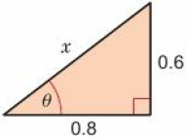
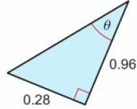
13.2 – Graph of the Sine Function
Page 402
a. Find the value of x in this triangle.
Find the value of sin $θ.$
Find the value of sin $θ$ in this triangle.
Warm Up

Slide 21
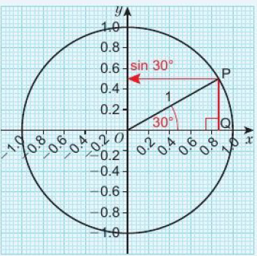
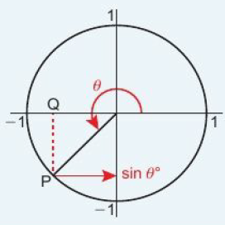
13.2 – Graph of the Sine Function
Page 402
Key Point 1
The diagram shows a circle of radius 1 unit with centre at (0, 0).
sin 30⁰ = $\frac{PQ}{1}$ = PQ = 0.5
The length of PQ gives the sine of the angle. This is shown on the vertical axis by the position of the arrow.
You can find the sine of any angle using this method.

Slide 22
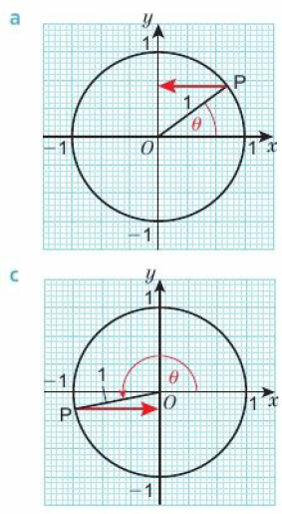
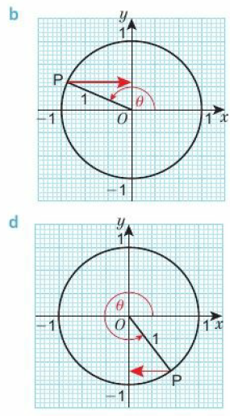
13.2 – Graph of the Sine Function
Page 403
Find the value of sin $θ.$ In each diagram.

Slide 23
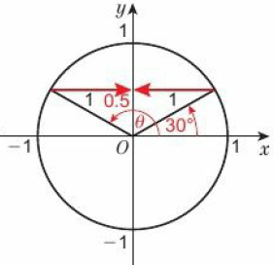
13.2 – Graph of the Sine Function
Page 403
a. What is the largest value that sin $θ$ can take?
What is the smallest value that sin $θ$ can take?
Find two values of B so that sin $θ$ = 0.
sin 30° = 0.5. Use the diagram to find an obtuse angle $θ$ such that sin $θ$ = 0.5.
Q4 hint - Look at the diagrams in Q3.

Slide 24
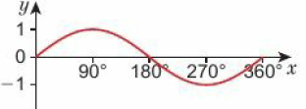
13.2 – Graph of the Sine Function
Page 404
As $θ$ increases from 0° to 90°, sin $θ$ increases from 0 to 1. Copy and complete these statements in the same way.
As $θ$ increases from 90° to 180°, sin $θ$ ___________________________
As $θ$ increases from 180° to 270°, sin $θ$ ________________________
As $θ$ increases from 270° to 360°, sin $θ$ ________________________
Here is a sketch of the graph of y = sin x for 0° ≤ x ≤ 360°. Describe the symmetry of the curve.

Slide 25
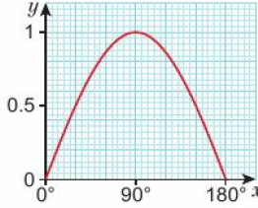
13.2 – Graph of the Sine Function
Page 404
Here is the graph of y = sin x for 0° ≤ x ≤ 180°.
Use the graph to find
sin90° ii. sin75°.
Describe the symmetry of the curve.
Use the graph to check your answer to Q6.
Copy and complete, inserting numbers greater than 90.
sin 60°= sin □°
sin45° = sin □°
sin0° = sin □°
sin30° = sin □°
Use the graph to give estimates for the solutions to sin x = 0.25.
Q7b hint - The graph of y = sin x for 0° ≤ x ≤ 180° is symmetrical about x = □°.
Q7d hint - Draw a horizontal line through sin 60° on the graph. Where else does it cross the graph?
Q7e hint - Give both values of x.

Slide 26
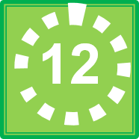
13.2 – Graph of the Sine Function
Page 404
The graph of y = sin x repeats every 360° in both directions,
Sketch the graph of y = sin x for 0° ≤ x ≤ 540°.
Use your sketch to find
sin 540° ii. sin 450°.
The exact value of sin 60° is $\frac{\sqrt{3} }{2}$. Write down the exact value of
sin 420° ii. sin 480°.
Explain how you worked out your answers to part c.
a. Write down four values of x such that sin x = -0.5.
Write down four values of x such that sin x = -$\frac{\sqrt{3} }{2}$
Check each of your answers using your calculator.
Q9a hint - Include x values 0°, 90°, 180°, 270°, 360°, 450°, 540° and y values 1, 0.5, 0, -0. 5, -1.

Slide 27
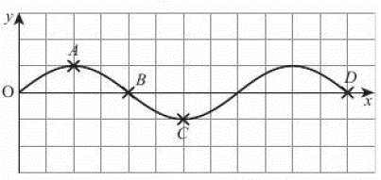
13.2 – Graph of the Sine Function
Page 404
11 – Exam-Style Questions
Here is a sketch of y = sin x. Write down the coordinates of each of the labelled points. (4 marks)
Q11 strategy hint - Check your answers by seeing if sin x = y

Slide 28
13.2 – Graph of the Sine Function
Page 405
Example 2
Solve the equation 5 sin x = 3 for values of x in the interval 0° to 540°.
5 sin x = 3
sin x = $\frac{3}{5}$ therefor x = sin⁻¹($\frac{3}{5}$)
x = 36.9°to 1 dp.
From the graph, the other values of x are:
180⁰ - 36.9⁰ =143.1⁰
360⁰ + 36.9° = 396.9“
540⁰ -36.9⁰ = 503.1⁰
Divide both sides of the equation by 5.
Use sin⁻¹ to find one value of x from your calculator.
Sketch the graph of y = sin x for the interval 0° to 540°. Use the graph to find the other values.

Slide 29
13.2 – Graph of the Sine Function
Page 405
Solve the equation 8 sin x = 2.5 for all values of x in the interval 0° to 720°.
Solve the equation 6 sin $θ$= 5 for all values of 6 in the interval 0° to 720°.
Reflect Did you use the worked example to help you answer Q12 and Q13? How does a worked example help you understand and answer questions like this?

Slide 30
13.3 – Graph of the Cosine Function
Page 402
Objectives |  | Did You Know?
Understand how to find the cosine of any angle. Know the graph of the cosine function and use it to solve equations. |  | Ultrasound scanners use trigonometry to construct pictures of babies in the womb.
Fluency
What is the exact value of cos 30° cos 45° cos 60° cos 90⁰?
ActiveLearn - Homework, practice and support: Higher 13.3

Slide 31
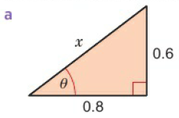
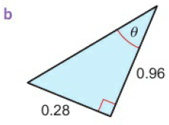
13.3 – Graph of the Cosine Function
Page 405
Find the value of cos $θ$ in each triangle.
Warm Up

Slide 32
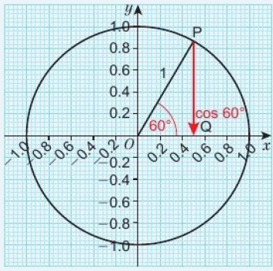
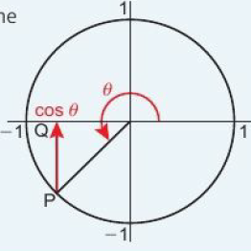
13.3 – Graph of the Cosine Function
Page 406
Key Point 2
The diagram shows a circle of radius 1 unit with centre at (0, 0).
cos 60⁰ = $\frac{OQ}{1}$ = OQ = 0.5
The length of OQ gives the cosine of the angle. This is shown on the horizontal axis by the position of the arrow. You can find the cosine of any angle using this method.

Slide 33
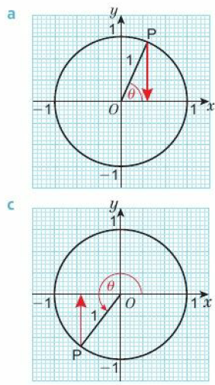
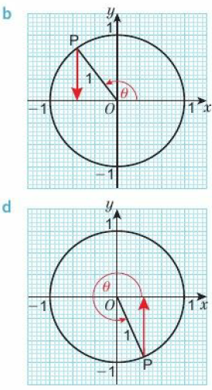
13.3 – Graph of the Cosine Function
Page 406
Find the value of cos $θ$ in each diagram.

Slide 34
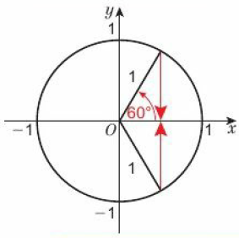
13.3 – Graph of the Cosine Function
Page 406
cos $600$ = 0.05 Use the diagram to find a reflex angle $θ$ such that cos $θ$ = 0.5.
cos $300$ = $\frac{\sqrt{3}}{2}$
Find a reflex angle $θ$ such that cos $θ$ = $\frac{\sqrt{3}}{2}$.
Find an obtuse angle such that cos $θ$ = -$\frac{\sqrt{3}}{2}$.
Q4 hint – Draw a diagram like the one in Q3 and make use of symmetry.

Slide 35
13.3 – Graph of the Cosine Function
Page 407
As 𝜃 increases from 0° to 90°, cos 𝜃 decreases from 1 to 0. Copy and complete these statements in the same way.
As 𝜃 decreases from 90° to 180°, cos 𝜃 ______________________
As 𝜃 increases from 180° to 270°, cos 𝜃 _____________________
As 𝜃 increases from 270° to 360°, cos 𝜃______________________

Slide 36
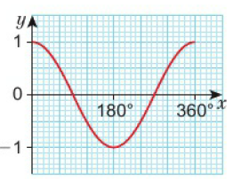
13.3 – Graph of the Cosine Function
Page 407
Here is the graph of y = cos x for 0° ≤ x ≤ 360⁰.
Use the graph to find
cos 120° ii. cos 180°.
Describe the symmetry of the curve,
Copy and complete:
cos 60° = cos □°
cos 90° = cos □°
cos 120° = cos □°
cos 0° = cos □°
Q6c hint - Draw a horizontal line through cos 60° on the graph. Where does it cross the graph?

Slide 37
13.3 – Graph of the Cosine Function
Page 407
The graph of y = cos x repeats every 360° in both directions,
Sketch the graph of y = cos x for 0° ≤ x ≤ 720°.
Use your graph to find
cos 300° ii. cos480°.
The exact value of cos 30° is $\frac{\sqrt{3} }{2}$. Write down the exact value of
cos 390⁰
cos 210⁰
Q7a hint - Include x values 0°, 90°, 180°, 270°, 360°,..., 720° and y values 1, 0.5, 0, -0.5, -1.

Slide 38
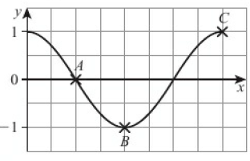
13.3 – Graph of the Cosine Function
Page 407
Use your sketch from Q7 to find four values of x such that
cos x = 0.5 b. cos x = - $\frac{\sqrt{3} }{2}$
Check your answers using a calculator.
9 – Exam-Style Questions
The diagram shows a sketch of the graph y = cos x° Write down the coordinates of points A, B and C. (3 marks)

Slide 39
13.3 – Graph of the Cosine Function
Page 407
6 cos x = 4.86
Use cos⁻¹ on your calculator to find one value of x.
Sketch the graph of y = cos x for the interval 0° to 720°.
Use your answers to parts a and b to solve 6 cos x = 4.86 for values of x in the interval 0° to 720°.
Solve the equation 15 cos $θ$ = -6.8 for values of $θ$ in the interval 0° to 720°.

Slide 40
13.4 – The Tangent Function
Page 408
Objectives |  | Did You Know?
Understand how to find the tangent of any angle. Know the graph of the tangent function and use it to solve equations. |  | Astronomers use trigonometry to predict the positions of comets.
Fluency
What is the exact value of tan 30° tan 45° tan 60°?
ActiveLearn - Homework, practice and support: Higher 13.4

Slide 41
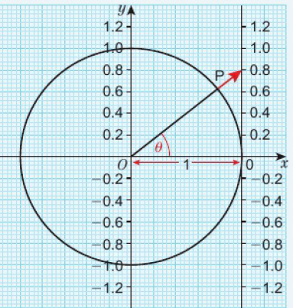
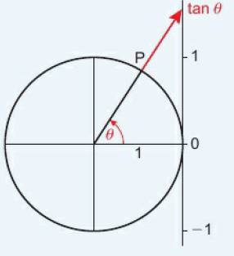
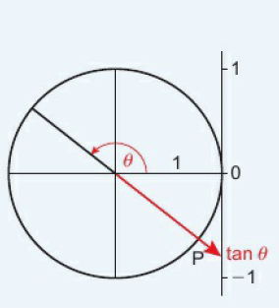
13.4 – The Tangent Function
Page 408
Key Point 3
The diagram shows a circle of radius 1 unit with centre at (0, 0).
tan $θ$ = $\frac{0.8}{1}$ = 0.8.
Extending OP to hit the vertical tangent line gives the value of tan $θ$.
You can find the tangent of any angle using this method except for angles of the form 900 ± 180n⁰. Unlike sine and cosine, the tangent can take any value, positive or negative, not just values between -1 and 1.

Slide 42
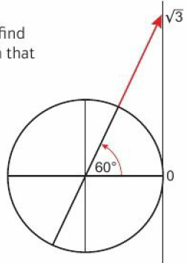
13.4 – The Tangent Function
Page 408
a. Find the value of x in this triangle.
Find the value of tan $θ$.
tan 60⁰ = $\sqrt{3}$ Use the diagram to find a reflex angle $θ$ such that tan $θ$ = $\sqrt{3}$
Warm Up

Slide 43
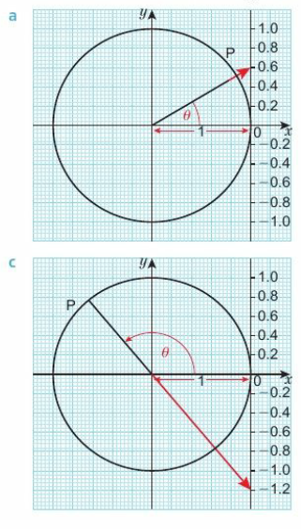
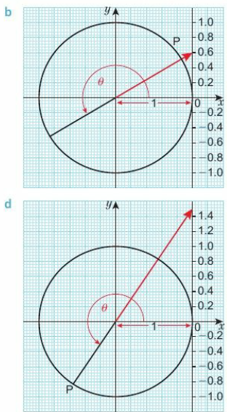
13.4 – The Tangent Function
Page 409
Find the value of tan $θ$ in each diagram.

Slide 44
13.4 – The Tangent Function
Page 409
tan 45⁰ = 1
Find a reflex angle $θ$ such that tan $θ$ = -1
Find an obtuse angle such that tan $θ$ = -1
Reflect The hint suggested drawing a diagram to help you answer this question. Did it help? How?
As $θ$ increases from 0° to 90°, tan $θ$ increases from 0 to infinity. Copy and complete these statements in the same way.
As $θ$ decreases from 180° to 90°, tan $θ$ _______________________________
As $θ$increases from 180° to 270°, tan $θ$ _______________________________
As $θ$ decreases from 360° to 270°, tan $θ$ _____________________________
Discussion tan $θ$ is not defined when $θ$ is 90° or 180°, for example. Why do you think this is?

Slide 45
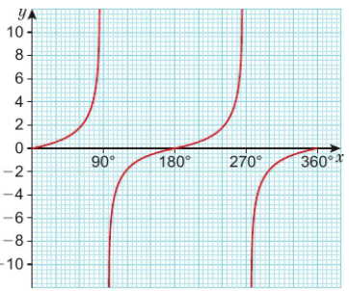
13.4 – The Tangent Function
Page 410
Here is the graph of y = tan x for 0° ≤ x ≤ 360°.
How often does the graph repeat?
Use the graph to estimate the value of
tan 60°
tan 300°.
Describe the symmetry of the curve,
Copy and complete, inserting numbers greater than 180.
tan60° = tan □°
tan 100° = tan □°
tan 120° = tan □°

Slide 46
13.4 – The Tangent Function
Page 410
a. Sketch the graph of y – tan x for 0° ≤ 0 ≤ 540°.
Use your sketch to find i tan 540° ii tan 405°.
The exact value of tan 60° is $\sqrt{3}$. Write down the exact value of
tan 240° ii. tan 120°.
Explain how you worked out your answers to part c.
a. Write down four values of x such that tan x = 1.
Write down four values of x such that tan x = -1.
Check your answers using a calculator.
Solve the equation 4 tan 𝜃 = 15.7 for values of 𝜃 in the interval 0° ≤ x ≤ 720°.

Slide 47
13.4 – The Tangent Function
Page 410
3 tan x = 11
Use tan⁻¹ on your calculator to find one value of x.
Sketch the graph of y = tan x for the interval 0° to 540°.
Use your answers to parts a and b to solve 3 tan x = 11 for values of x in the interval 0° to 540°.
11 – Exam-Style Questions
Sketch the graph of y = tan x in the interval 0° to 720°.
Given that tan 30° = $\frac{1}{\sqrt{3}}$ solve the equation 3 tan x = $\sqrt{3}$in the interval 0° to 720°. (4 marks)
Exam hint - You are expected to use your sketch from part a to solve the equation in part b.

Slide 48
13.5 – Calculating Areas and the Sine Rule
Page 408
Objectives |  | Did You Know?
Find the area of a triangle and a segment of a circle. Use the sine rule to solve 2D problems. |  | Sat navs use trigonometry to calculate the position of a vehicle.
Fluency
Calculate the area of each triangle.
ActiveLearn - Homework, practice and support: Higher 13.5

Slide 49
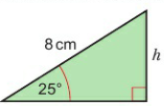
13.5 – Calculating Areas and the Sine Rule
Page 411
Write a formula for calculating the area. A, of each shape.
Calculate the perpendicular height, h, of this triangle.
Warm Up

Slide 50
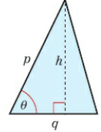
13.5 – Calculating Areas and the Sine Rule
Page 411
a. Write h, the perpendicular height of the triangle, in terms of p and $θ$
Write a formula in terms of p and $θ$ to calculate the area of the triangle.
Q3 hint - You need to use trigonometry as in Q2.

Slide 51
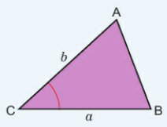
13.5 – Calculating Areas and the Sine Rule
Page 411
Key Point 4
The area of this
triangle = ½ab sin C.
a is the side
opposite angle A.
b is the side opposite
angle B.
Find the area of each triangle.
Q4 hint - First label vertex C (the given angle). Then label vertices A and B, and their opposite sides a and b.

Slide 52
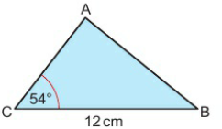
13.5 – Calculating Areas and the Sine Rule
Page 412
The area of triangle ABC is 38.8 cm². Work out the length of AC.

Slide 53
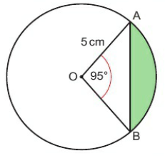
13.5 – Calculating Areas and the Sine Rule
Page 412
a. Find the area of triangle AOB in this circle.
Find the area of the sector AOB.
Find the area of the shaded segment of the circle.
Q6b hint –
Q6c hint - How can you use your answers to parts a and b to find the answer to part c?

Slide 54
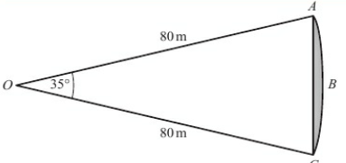
13.5 – Calculating Areas and the Sine Rule
Page 412
7 – Exam-Style Questions
ABC is an arc of a circle centre O with radius 80 m. AC is a chord of the circle.
Angle AOC = 35°.
Calculate the area of the shaded region. Give your answer correct to 3 significant figures. (5 marks)
March 2012, Q23, 1380/4H
Q7 strategy hint - Find the area of sector OABC and the area of triangle OAC.

Slide 55
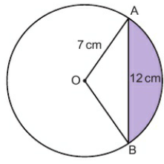
13.5 – Calculating Areas and the Sine Rule
Page 412
Problem-solving
a. Calculate angle AOB. Give your answer correct to 1 decimal place.
Work out the area of the shaded segment. Give your answer correct to 3 significant figures.
Q8a hint – Split the triangle into two right-angled triangles.

Slide 56
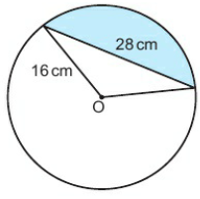
13.5 – Calculating Areas and the Sine Rule
Page 413
Problem-solving In the diagram, O is the centre of the circle. Work out the area of the shaded segment. Give your answer correct to 3 significant figures.

Slide 57
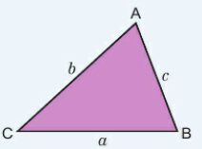
13.5 – Calculating Areas and the Sine Rule
Page 413
Key Point 5
The sine rule can be used in any triangle.
$\frac{a}{sin A}$ = $\frac{b}{sin B}$ = $\frac{c}{sin C}$ Use this to calculate an unknown side.
$\frac{sin A}{a}$ = $\frac{sin B}{b}$=$\frac{sin C}{c}$ Use this to calculate an unknown angle.
To use the sine rule you need to know one angle and the opposite side. Then:
if you know another angle, you can work out the length of its opposite side
if you know another side, you can work out the size of its opposite angle.

Slide 58
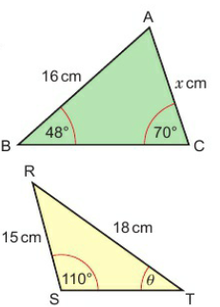
13.5 – Calculating Areas and the Sine Rule
Page 413
Example 3
Find the value of x. Give your answer to 3 s.f.
Find the value of $θ$. Give your answer to 1 d.p.
a. $\frac{x}{ sin 480}= \frac{16}{sin 700}$ x = $\frac{16sin480}{sin 700}$ = 12.653
b. $\frac{sinθ}{15}= \frac{sin 1100}{18}$
sin $θ$ = $\frac{15 sin 1100}{18}$
$θ$ = sin⁻¹ ($\frac{15 sin 1100}{18}$) = 51.5⁰ (1 d.p.)
Use the sine rule $\frac{b}{ sin b}= \frac{c}{sin c}$
Multiply both sides by sin48⁰
Use the sine rule $\frac{sin T}{ t}= \frac{sin S}{s}$.
Multiply both sides by 15.
Use sin⁻¹ on your calculations

Slide 59
13.5 – Calculating Areas and the Sine Rule
Page 414
Find the length of the side labelled x in each diagram. Give your answers correct to 3 significant figures.

Slide 60
13.5 – Calculating Areas and the Sine Rule
Page 414
Find the size of angle 0 in each diagram. Give your answers correct to 1 decimal place.

Slide 61
13.5 – Calculating Areas and the Sine Rule
Page 414
a. Work out the length of AC. Give your answer correct to 3 significant figures,
Work out the size of angle BAC. Give your answer correct to 1 decimal place.

Slide 62
13.5 – Calculating Areas and the Sine Rule
Page 414
In triangle ABC, AB = 8 cm, BC = 6cm and angle BAC = 40°. Work out the size of angle ACB. The diagram shows that there are two possible triangles. Hence there are two possible answers. Give both, correct to 1 decimal place.
In triangle XYZ, XY = 12cm, YZ = 9.5cm and angle YXZ = 50°. Work out the size of angle XZY. There are two possible answers. Give each of them correct to 1 decimal place.
Q3 hint - Draw a diagram. Use the sine rule to find the value of sinC. Use the sine graph to find the two possible values.

Slide 63
13.6 – The Cosine Rule and 2d Trigonometric Problems
Page 415
Objectives |  | Did You Know?
Use the cosine rule to solve 2D problems. Solve bearings problems using trigonometry. |  | Trigonometry was needed to dig the Channel Tunnel. The undersea part is the longest in the world, at 37.9 km. Digging from both sides, the engineers met under the sea and were delighted to find that they were just 2cm out.
Fluency
Work out the value of 3 + 4 x 5 9 + 8 - 2 x 5
ActiveLearn - Homework, practice and support: Higher 13.6

Slide 64
13.6 – The Cosine Rule and 2d Trigonometric Problems
Page 415
In the diagram, what is the bearing of
B from A
A from B?
Work out the positive value of x when x² = 9² + 72 – 2 x 9 x 7 x cos 34°. Give your answer correct to 3 significant figures.
Warm Up

Slide 65
13.6 – The Cosine Rule and 2d Trigonometric Problems
Page 415
Find the area of this triangle. Give your answer correct to 3 significant figures.
Warm Up
Key Point 6
The cosine rule can be used in any triangle.
a² = b² + c² – 2bccos A Use this to calculate an unknown side.
cosA = $\frac{\text{b}\text{2}\text{ + }\text{c}\text{2} −\text{a}\text{2}}{\text{2}\text{bc}}$ Use this to calculate an unknown angle.
You can use the cosine rule to find:
the length of a side if you know two sides and the included angle
an unknown angle if you know all three sides.

Slide 66
13.6 – The Cosine Rule and 2d Trigonometric Problems
Page 416
Example 4
Work out the length of the side labelled x. Give your answer to 3 significant figures.
Work out the size of angle y. Give your answer correct to 1 d.p.

Slide 67
13.6 – The Cosine Rule and 2d Trigonometric Problems
Page 416
Example 4
Sketch the triangle. Label the missing side a and the others b and c.
Use the cosine rule to find the side.
Use the cosine rule to find the angle.

Slide 68
13.6 – The Cosine Rule and 2d Trigonometric Problems
Page 416
Find the length of the sides marked with letters in these diagrams. Give your answers correct to 3 significant figures.

Slide 69
13.6 – The Cosine Rule and 2d Trigonometric Problems
Page 417
Calculate the angles marked with letters in these triangles. Give your answers correct to 1 decimal place.

Slide 70
13.6 – The Cosine Rule and 2d Trigonometric Problems
Page 417
In the diagram, O is the centre of the circle of radius 5 cm. AB is a chord of length 8cm. Work out the size of angle AOB.
Q6 hint – What is the length of OA?

Slide 71
13.6 – The Cosine Rule and 2d Trigonometric Problems
Page 417
Reasoning
Work out the length of PR. Give your answer correct to 3 significant figures,
Work out the size of angle QPR. Give your answer correct to 1 decimal place,
Work out the area of quadrilateral PQRS Give your answer correct to 3 significant figures.
Reflect In this question you were asked to give answers to 3 significant figures and to 1 decimal place. Explain the difference between giving an answer 'to significant figures’ and 'to decimal places’.

Slide 72
13.6 – The Cosine Rule and 2d Trigonometric Problems
Page 417
Reasoning The diagram shows the positions of three towns. A, B and C. Calculate the bearing of C from A.
Find the size of each lettered angle.
Q10 hint – For each one, decide whether to use the sine rule or the cosine rule.

Slide 73
13.6 – The Cosine Rule and 2d Trigonometric Problems
Page 418
11 – Exam-Style Questions
ABC is a triangle.
BC is 12.3cm
Angle ABC = 73⁰
The area of the triangle ABC is 50cm²
Work out the length of AC.
Give your answer correct to 3 significant figures. (6 marks)
June 2013, Q19, 5MB3H/01
Exam hint
You need to know the sine rule the cosine rule and the formula for the area of a triangle 5-how any formulae you use in your working.

Slide 74
13.7 – Solving Problems in 3D
Page 418
Objectives |  | Did You Know?
Use Pythagoras ’theorem in 3D. Use trigonometry in 3D. |  | Pythagoras ’theorem can be extended into three dimensions-and more (if there are any).
Fluency
Which rule would you use to work out x in these diagrams?
ActiveLearn - Homework, practice and support: Higher 13.7

Slide 75
13.7 – Solving Problems in 3D
Page 418
Find the size of angle $θ$ in each triangle.
Find the value of x in each triangle. Give your answers correct to 3 significant figures.
Warm Up

Slide 76
13.7 – Solving Problems in 3D
Page 419
Key Point 7
A plane is a flat surface. For example, the surface of your desk lies in a horizontal plane; the surface of a wall in your classroom lies in a vertical plane.
In the diagram, BC is perpendicular to the plane WXYZ. Triangle ABC is in a plane perpendicular to the plane WXYZ. d is the angle between the line AB and the plane WXYZ.

Slide 77
13.7 – Solving Problems in 3D
Page 419
Example 5
Work out the length of the diagonal, AG, of this cuboid.
Find the angle that AG makes with the plane EFGH.
The base EFGH is in a horizontal plane and triangle AEG is in a vertical plane. The length of the diagonal AG is x.
The angle that AG makes with EFGH is $θ$.

Slide 78
13.7 – Solving Problems in 3D
Page 419
Example 5
EG² = 9² + 122 = 225 EG = $\sqrt{225}$ = 15cm x² = 8² + 15² = 289 x = $\sqrt{289}$ = 17 The diagonal AG is 17cm long.
tan$θ$ = $\frac{8}{15}$ = 28.1⁰ (1d.p.) The angle that AG makes with the plane EFGH is 28.1⁰ to 1 d.p.
First look at the right-angled triangle EGH. Use Pythagoras’s theorem to find the length of EG.
Use the lengths given in this question when you can.
Now look at the triangle AEG. Label the length of EG you have just found. Use Pythagoras to work out x.

Slide 79
13.7 – Solving Problems in 3D
Page 420
Reasoning ABCDEFGH is a cuboid,
Calculate the length of diagonals
FH ii. BH iii. FC iv. CE.
Find the angle between the diagonal DF and the plane EFGH.
Find the angle between the diagonal GA and the plane ABCD.
Find the angle between the diagonal CE and the plane AEHD.
Q3 hint – Sketch separate triangles using information from the cuboid.

Slide 80
13.7 – Solving Problems in 3D
Page 420
Problem-solving In the diagram, ABCDEF is a prism. The cross-section is a right-angled triangle. All of the other faces are rectangles. Calculate the angle that the diagonal AC makes with the plane CDEF.

Slide 81
13.7 – Solving Problems in 3D
Page 420
Reasoning In the diagram, ABCD is a tetrahedron.
Work out the length of AC.
Work out the length of CD.
Given that BD = 12cm, calculate angle BCD.
Q5 hint - Sketch each triangle separately. Put as many lengths/angles as possible on your sketch to help you answer the questions.

Slide 82
13.7 – Solving Problems in 3D
Page 420
Reasoning ABCDE is a square-based pyramid. The base BCDE lies in a horizontal plane. AB = AC = AD = AE = 24 cm. AM is perpendicular to the base,
Calculate the length of
CE
CM
AM.
Calculate the angle that AB makes with the base, correct to the nearest degree,
Calculate the angle between AM and the face ACD, correct to the nearest degree.

Slide 83
13.7 – Solving Problems in 3D
Page 421
7 – Exam-Style Questions
The diagram shows a square-based pyramid ABCDE.
Each triangular face is an isosceles triangle,
Calculate the length of the diagonal BD. Give your answer correct to 3 significant figures,
Calculate the area of triangle ABD. Give your answer correct to 3 significant figures. (6 marks)
Q7 strategy hint - For each part, draw a right-angled triangle and label it with the given information.

Slide 84
13.7 – Solving Problems in 3D
Page 421
Problem-solving ABCDE is a pyramid with a rectangular base. AB = AC = AD = AE = 28cm. Calculate the size of angle BAD correct to the nearest degree.
Reflect When you answered the questions in this lesson, did you make any mistakes? Do you understand where you went wrong? Was there a pattern?
Q8 hint – Sketch triangle BAD

Slide 85
13.8 – Transforming Trigonometric Graphs 1
Page 418
Objectives |  | Did You Know?
Recognise how changes in a function affect trigonometric graphs. |  | If you plot the depth of water in a harbour against time, the graph is a simple transformation of a simple sine or cosine curve. The same is true of many quantities that vary over time, including mains voltage and light waves.
Fluency
Find the image of the point (3,5) under each of these transformations, a. reflection in the x-axis b. reflection in the y-axis c. rotation through 180° about (0,0)
ActiveLearn - Homework, practice and support: Higher 13.8

Slide 86
13.8 – Transforming Trigonometric Graphs 1
Page 421
Write down the exact value of
sin 60° b. tan 30°
cos45° d. sin0°
cos 90° f. tan 60°.
Sketch these graphs for values of x from 0 to 360°.
y = sin x
y = cos x
y = tan x
Warm Up

Slide 87
13.8 – Transforming Trigonometric Graphs 1
Page 422
Here is the graph of y = sin x for -180° ≤ x ≤ 180°.
Copy the table.
Write in the values of x and sin x at points A to H on the graph.
For each x-value, write in the value of -sinx.
Sketch the graph of y = -sinx for -180° ≤ x ≤ 180°.
Describe how the graph of y = sinx is transformed to give the graph of y = -sinx.

Slide 88
13.8 – Transforming Trigonometric Graphs 1
Page 422
Key Point 8
The graph of y = -f(x) is the reflection of the graph of y = f(x) in the x-axis.
a. Use your table from Q3. Add a column for sin (-x). Find the sine values from the graph to fill in the sin (- x) column,
Sketch the graph of y = sin(-x) for -180° ≤ x ≤ 180°.
Describe the transformation that turns the graph of y = sin x into the graph of y = sin (-x).
Key Point 9
The graph of y = f(-x) is the reflection of the graph of y = f(x) in the y-axis.

Slide 89
13.8 – Transforming Trigonometric Graphs 1
Page 422
Here is the graph of y = tan x for -180° ≤ x ≤ 180°. Sketch the graph of y = tan(-x) for -180° ≤ x ≤ 180°.

Slide 90
13.8 – Transforming Trigonometric Graphs 1
Page 422
a. Look at your graph of y = -sinx for -180° ≤ x ≤ 180° in Q3. What transformations will turn the graph of y = -sinx into the graph of y = -sin(-x)?
Sketch the graph of y = -sin(-x). What do you notice?
Key Point 10
The graph of y = -f(-x) is a reflection of the graph of y = f(x) in the x-axis and then the y-axis, or vice versa. These two reflections are equivalent to a rotation of 180° about the origin.

Slide 91
13.8 – Transforming Trigonometric Graphs 1
Page 422
Communication Explain why the graph of y = -sin(-x) is the same as the graph of y = sin x.
a. Sketch the graph of y = cos x for -180° ≤ x ≤ 180°.
Sketch the graph of y = -cos(-x).
a. Describe the transformation that maps the graph of y = tan x to the graph of y = tan(- x).
Sketch the graph of y = tan x and the graph of y = tan (-x) for the interval 0 to 360°.
Q7 hint – Sketch the graphs.
Q8 hint – Rotate y = cosx by 180° about the origin.

Slide 92
13.8 – Transforming Trigonometric Graphs 1
Page 423
a. Describe the transformation that maps the graph of ^ = cosx to the graph of y = - cosx.
Sketch the graphs of y = cosx and y = -cosx for the interval -180° to 180°.
a. Describe the transformation that maps the graph of y = tanx to the graph of y = -tan(- x).
Sketch the graphs of y = tanx and y = -tan(-x) for the interval -180° to 180°.

Slide 93
13.8 – Transforming Trigonometric Graphs 1
Page 423
12 – Exam-Style Questions
Here is a sketch of the graph of y = -sinx. Write down the coordinates of each of the labelled points. (3 marks)
Q12 strategy hint - This curve is a transformation of the graph of y = sin*.

Slide 94
13.9 – Transforming Trigonometric Graphs 2
Page 423
Objectives |  | Did You Know?
Recognise how changes in a function affect trigonometric graphs. |  | The sine and cosine curves are identical in shape but 90⁰ ‘out of phase’, meaning that you can shift one horizontally to get the other.
Fluency
Is the graph of y = -cos(-x) the same as the graph of y – cos x?
ActiveLearn - Homework, practice and support: Higher 13.9

Slide 95
13.9 – Transforming Trigonometric Graphs 2
Page 423
a. The point (30, 0.5) is translated by the vector (${0 \atop 2}$) What are the coordinates of the new point?
The point (45,1) is translated by the vector (${−15 \atop 1}$) What are the coordinates of the new point?
Warm Up
Key Point 11
The graph of y = f(x) + a is the translation of the graph of y = f(x) by (${0 \atop a}$)

Slide 96
13.9 – Transforming Trigonometric Graphs 2
Page 423
a. Copy the graph of y = sinx for -180° ≤ x ≤ 180° from Q3 in lesson 13.8.
Add 0.5 to the y-coordinate at each of the labelled points.
Draw the sine graph that passes through the new points. Label it y = sinx + 0.5.
Describe the transformation from the graph of y = sinx to this graph,
Now subtract 0.5 from the y-coordinate at each of the labelled points on the original graph,
Draw the sine graph that passes through the new points,
Describe the transformation from the graph of y = sinx to this graph.
Write down the equation of the graph.

Slide 97
13.9 – Transforming Trigonometric Graphs 2
Page 424
Write down the equation of each graph.
Q3 hint - First decide whether it is a sin, cos or tan graph.

Slide 98
13.9 – Transforming Trigonometric Graphs 2
Page 424
Here is the graph of y = cosx for 0° ≤ x ≤ 360°.
Copy and complete this table of values for cos(x + 30°).
Sketch the graph of y = cos(x + 30°).
Describe the transformation that takes the graph of y = cos x to the graph of y = cos(x + 30°).
x | 0⁰ | 30⁰ | 60⁰ | 90⁰
cos(x + 30⁰) | Cos 30⁰ = □
Q4 hint - Draw a table of values for x and y.

Slide 99
13.9 – Transforming Trigonometric Graphs 2
Page 424
Describe the transformation of the graph of y = cosx to make the graph with equation
y = cos(x + 60°)
y = cos(x + 20°)
y = cos(x - 30°).
Describe the transformation of the graph of y = tanx to make the graph with equation
y = tan(x + 40°)
y = tan(x + 30°)
y = tan(x - 60°).

Slide 100
13.9 – Transforming Trigonometric Graphs 2
Page 424
Match each graph below with one of these equations.
y = tan(x - 30°) B. y = sin(x + 45°)
y = cos(x + 45°)
Sketch the graphs of these functions for 0⁰ ≤ x ≤ 360°.
y = sin3x b. y = cos2x c. y = tan2x

Slide 101
13.9 – Transforming Trigonometric Graphs 2
Page 425
a. Sketch the graph of y = sinx for 0° ≤ x ≤360°.
Copy and complete the table of values for y = 2 sin x.
On the same axes, sketch the graph of y = 2 sin x.
X | 0⁰ | 30⁰ | 60⁰ | 90⁰ | 120⁰
sinx | 0 | 0.5
2 sinx | 0
Key Point 13
The graph of y = a f(x) is a vertical sketch of the graph of y = f(x) with a scale factor a, parallel to the y-axis.

Slide 102
13.9 – Transforming Trigonometric Graphs 2
Page 425
Sketch the graphs of these functions for 0° ≤ x ≤ 360°.
y = 3 cos x b. y = -2 tan x
y = -2 sin x
a. Copy your sketch graph of y = sinx for 0° ≤ x ≤ 360° from Q8.
Copy and complete the table of values for y = sin (2x).
x | 0⁰ | 30⁰ | 60⁰ | 90⁰ | 120⁰
sin(2x)
Key Point 14
The graph of y = f(ax) is a horizontal sketch of the graph of y = f(x) with a scale factor $\frac{1}{a}$, parallel to the x-axis.

Slide 103
13.9 – Transforming Trigonometric Graphs 2
Page 425
12 – Exam-Style Questions
The diagram shows part of a sketch of the curve y = sin 2°
Write down the coordinates of the point P. (1 mark)
Write down the coordinates of the point Q. (1 mark)
Here is a sketch of the curve y = a cos bx° + c, 0 ≤ x ≤ 360
Find the values of a, b and c.
(3 marks)
June 2014, Q26, 1MAO/IH
Q12c strategy hint - a is related to the vertical stretch factor, b is related to the horizontal stretch factor and c is related to the vertical translation.

Slide 104
13 – Problem Solving: Muddy Tracks
Page 426
Objectives | Use Pythagoras' theorem and the cosine rule to solve problems in 2D.
An expedition needs to cross over the square piece of land X (next) as quickly as possible, moving from A to B. They can walk at 5 km/h in the field, but slow down to a speed of 2 km/h when walking through the wood.
One approach would be to walk in a straight line from A to B.
Show that it would take the expedition 9 hours and 54 minutes to travel by this route.
Find a route which would be at least 30 minutes quicker to travel.
Land Y (below) has a different layout.
Find the quickest possible route over this piece of land. Give your answer to an appropriate degree of accuracy.
Q1 hint - You will need to use the formula, time = $\frac{distance}{speed}$
Q3 hint - Use trigonometry. You might choose to use a trial and improvement approach.

Slide 105
13 – Problem Solving: Muddy Tracks
Page 426

Slide 106
13 – Check Up
Page 427
Check Up | Log how you did on your Student Progression Chart
Accuracy and 2D problem-solving
Work out the area of this triangle.
Find the upper and lower bounds for the value of x in the diagram. Write x to a suitable level of accuracy.

Slide 107
13 – Check Up
Page 427
Calculate the length of the side labelled x in each diagram.
Find the size of the acute angle $θ$ in these triangles.

Slide 108
13 – Check Up
Page 427
Trigonometric graphs
Sketch the graph of y = tan $θ$ for -360° ≤ x ≤ 360°.
Here is the graph of y = cosx for 0° ≤ x ≤ 360°. Use the graph to solve cosx = 0.4

Slide 109
13 – Check Up
Page 428
Match each graph below with one of these equations.
y = 2sinx +1 B. y = 3cosx C. y = cos3x
Solve the equation 3sinx = 1 for 0° ≤ x ≤ 720°.

Slide 110
13 – Check Up
Page 428
3D Problem-solving
ABCDEFGH is a cuboid. Calculate the length of the diagonal AG.
ABCD is a tetrahedron. Calculate the length of
AC
CD.

Slide 111
13 – Check Up
Page 428
How sure are you of your answers? Were you mostly: Just guessing ☹ Feeling doubtful 😐 Confident ☺ What next? Use your results to decide whether to strengthen or extend your learning.
* Challenge
The angles that satisfy an equation in the interval 0° ≤ x ≤ 720° are 30°, 210°, 390° and 570°. Write down a possible equation.
Reflect

Slide 112
13 – Strengthen
Page 429
Strengthen
Accuracy and 2D problem-solving
a. Copy this triangle. Label the vertex at the given angle C, and the other two vertices A and B. Label the sides: a is opposite A and b is opposite B.
Use Area = ½absin C to find the area of the triangle.

Slide 113
13 – Strengthen
Page 429
a. Copy the triangle. Label the vertices A, B and C and the sides a, b and c.
Substitute the values from the diagram into the sine rule: $\frac{a}{sin A}$ = $\frac{b}{sin B}$ = $\frac{c}{sin C}$
Use two parts of the sine rule with values in them to find x. Give your answer correct to 3 significant figures.
Q3c hint –
$$\frac{x}{□}$$
=
$$\frac{□}{□}$$
Q3a hint –

Slide 114
13 – Strengthen
Page 429
Find the areas of these triangles.
Find the value of x in each triangle. Give your answers correct to 3 significant figures.
Q2 hint – use the method in Q1
Q4 hint – use the method in Q3

Slide 115
13 – Strengthen
Page 429
a. Copy the triangle. Label the vertices A, B and C and the sides a, b and c.
Substitute the values from the diagram into the sine rule: $\frac{sin A}{a}$ = $\frac{sin B}{b}$=$\frac{sin C}{c}$
Use two parts of the sine rule with values in them to find $θ$. Give your answer correct to 1 decimal place.
Q5c hint –
$$\frac{\sin{θ}}{□}$$
$$\frac{□}{□}$$
=

Slide 116
13 – Strengthen
Page 430
Find the size of the acute angle 0 in each triangle. Give your answers correct to 1 decimal place.
Calculate the value of x in each triangle. Give your answers correct to 3 significant figures.

Slide 117
13 – Strengthen
Page 430
a. Copy the triangle. Label the x side a, and the others b and c. Label the vertices A, B and C.
Substitute the values from the triangle into the cosine rule: a² = b² + c² – 2bccos A
Solve the equation to find x, correct to 3 significant figures.

Slide 118
13 – Strengthen
Page 430
a. Copy the triangle. Label the vertex and angle $θ$, A. Label the other vertices and the other sides.
Substitute the values from the triangle into the cosine rule: c$os A$ = $\frac{b2+c2 −a2}{2bc}$
Calculate the value of $θ$ correct to 1 decimal place.

Slide 119
13 – Strengthen
Page 430
Calculate the size of angle $θ$ in each triangle. Give your answers correct to 1 decimal place.
All the measures in this equation are given to 2 significant figures. x = 14tan36° Find the upper and lower bounds for the value of*.
Q12 hint - Use the same method as in Q11.

Slide 120
13 – Strengthen
Page 430
All the measures in this equation are given to 2 significant figures. x = $\frac{5.7}{sin 230}$
Copy and complete the table for the upper and lower bounds.
Find sin(upper bound for 23) and sin(lower bound for 23).
Which upper and lower bound values give the upper bound for x?
 | Upper bound value | Lower bound value
5.7 |  | 5.65
23 | 23.5
Q11c hint - Which values-one from each row of the table - give the smallest possible value of x?

Slide 121
13 – Strengthen
Page 431
Trigonometric graphs
a. Copy and complete the table for y = sin x.
Draw the graph of y = sin x for 0° ≤ x ≤ 180⁰
The sine graph is symmetrical about the line x = 90°.
Sketch the graph of y = sin x for 0° ≤ x ≤ 180⁰.
The graph of y = sin x has rotational symmetry about the point (180°, 0).
Extend your sketch from part c to cover the interval 0° ≤ x ≤ 360⁰.
x | 0⁰ | 10⁰ | 20⁰ | 30⁰ | 40⁰ | 50⁰ | 60⁰ | 70⁰ | 80⁰ | 90⁰
sin x

Slide 122
13 – Strengthen
Page 431
Trigonometric graphs
a. Copy and complete the table for y = tanx
Draw the graph of y = tan x for 0° ≤ x ≤ 80°.
What happens to the value of tan x as x increases from 80° towards 90°?
Sketch the graph of y = tan x for 0° ≤ x ≤ 90°.
The graph of y = tan x has rotational symmetry about the point (90°, 0).
Extend your sketch from part d to cover the interval 0° ≤ x ≤ 180°.
The graph of y = tan x repeats every 180°.
Extend your sketch from part e to cover the interval 0° ≤ x ≤ 360°.
x | 0⁰ | 10⁰ | 20⁰ | 30⁰ | 40⁰ | 50⁰ | 60⁰ | 70⁰ | 80⁰
tan x

Slide 123
13 – Strengthen
Page 431
Here is the graph for y = cos x for 0° ≤ x ≤ 360°.
Use the graph to estimate a solution for cos x = -0.6
Q3 hint - Find -0.6 on the vertical axis and read off the corresponding values from the curve. There are two values in the interval 0° ≤ x ≤ 360°..

Slide 124
13 – Strengthen
Page 432
a. Copy and complete this table of values.
Match each equation to a transformation of the sine or cosine graph.
y = 2sinx⁻¹ ii. y = 2cosx
y = sin2x⁻¹
Match each equation from part b to one of these graphs.
x | 0⁰ | 30⁰ | 90⁰
sinx | 0
sin2x – 1 |  | sin60⁰ – 1 =$\frac{\sqrt{3}}{2}$ -1
2sinx - 1 | 2 x 0 – 1 = -1

Slide 125
13 – Strengthen
Page 432
a. Rearrange the equation 4cosx = 3 to make cosx the subject,
Sketch the graph of y = cosx for 0° ≤ x ≤ 720°.
Use your calculator to find one value of x that satisfies the equation,
Use your sketch to solve the equation 4cosx = 3 for 0° ≤ x ≤ 720°.

Slide 126
13 – Strengthen
Page 432
3D Problem-solving
Reasoning The diagram shows a cuboid ABCDEFGH.
Sketch triangle CDG. Label the triangle with the information shown on the diagram,
Calculate the length of DG. Give your answer correct to 3 significant figures,
Sketch triangle DFG. Label the triangle with the information shown on the diagram and your answer to part b.
Calculate the angle that the diagonal DF makes with the plane DCGH.
Q1 hint - The angle between the diagonal DF and the plane DCGH is angle FDG on your sketch for part c Use your unrounded answer to part b.

Slide 127
13 – Strengthen
Page 433
Reasoning In the diagram, ABCD is a tetrahedron. AB = AC= 11cm.
Sketch triangle ABC. Label the triangle with the information shown on the diagram,
Calculate the length of BC. Give your answer correct to 3 significant figures,
Sketch triangle BCD. Label the triangle with the information shown on the diagram and your answer to part b.
Calculate angle BCD.
Q2 hint - Use your unrounded answer to part b.

Slide 128
13 – Extend
Page 433
Extend
a. Use the cosine rule to find the length of BC.
What do you notice about the cosine rule when A = 90°?
a. Write an expression for the area of this triangle using angle C.
Write two more expressions for the area of the triangle using angles B and A.
Using your answers to parts a and b, show that: $\frac{a}{sin A}$ = $\frac{b}{sin B}$ = $\frac{c}{sin C}$

Slide 129
13 – Extend
Page 434
Problem-solving The area of triangle ABC is 21 cm². Calculate the size of the obtuse angle ABC. The measurements are rounded to 1 d.p. Give your answer to a suitable level of accuracy.
Communication a. Sketch the graph of y = sinx,
From your graph, find
sin 45° ii. sin(180°- 45°).
What do you notice?
Explain why sin $θ$ = sin (180° - 6) for values between 0 and 180‘
Q6d hint – Draw lines on your graph

Slide 130
13 – Extend
Page 434
Problem-solving Find the area of the shaded segment in terms of r.
a. Sketch the graph of y = sinx.
Copy and complete this table of values for y = sin ($\frac{x}{2}$).
Sketch the graph of y = sin($\frac{x}{2}$) on the same axes as your graph of y = sinx.
x | 0⁰ | 60⁰ | 90⁰ | 120⁰
sin($\frac{x}{2}$) |  |  | $\frac{1}{\sqrt{2}}$ = 0.7

Slide 131
13 – Extend
Page 434
8 – Exam-Style Questions
Here are two triangles T₁ and T₂.
Diagram NOT accurately drawn
The lengths of the sides are in centimetres. The area of triangle T₁ is equal to the area of triangle T₂.
Work out the value of x, giving your answer in the form a + $\sqrt{b}$ where a and b are integers. (5 marks)
March 2013, Q25, 1MA0/2H
Q8 strategy hint - Write an equation using the area formulae ½absinC forT₁ and ½x base x height for T₂.

Slide 132
13 – Extend
Page 434
Modelling The depth, d metres, of water in a harbour at a time t hours after midnight is d = 12 + 5sin(30t), where 0 ≤ t ≤ 24. Sketch the graph of d against t.
Problem-solving ABCDE is a square-based pyramid. Calculate the volume of the pyramid. Give your answer correct to 3 significant figures.

Slide 133
13 – Extend
Page 435
Modelling The horizontal distance travelled by a ball in the time, t seconds from when it is kicked, is x metres, where x = 20t cos $θ$. Find the value of $θ$ given that x = 25 when t = 1.5.
Problem-solving
Find the value of* in triangle ABC.
The exact value of the area of triangle ABC is $\sqrt{3}$ k cm². Find the value of k.

Slide 134
13 – Knowledge Check
Page 435
13 – Knowledge Check
The sine graph repeats every 360⁰ in both directions. The cosine graph repeats every 360⁰ in both directions.
Mastery Lesson 13.2
Mastery Lesson 13.3

Slide 135
13 – Knowledge Check
Page 435
13 – Knowledge Check
The tangent graph repeats every 180⁰ in both directions. tan x is not defined for angles of the form (90 ± 180n°) The area of this triangle = ½absinC
Mastery Lesson 13.4
Mastery Lesson 13.5
Mastery Lesson 13.5

Slide 136
13 – Knowledge Check
Page 436
13 – Knowledge Check
The sine rule can be used in any triangle. $\frac{a}{sin A}$ = $\frac{b}{sin B}$ = $\frac{c}{sin C}$ Use this to calculate an unknown side. $\frac{sin A}{a}$ = $\frac{sin B}{b}$=$\frac{sin C}{c}$ Use this to calculate an unknown angle The cosine rule can be used in any triangle, a² = b² + c² – 2bccos A Use this to calculate an unknown side. cosA = $\frac{\text{b}\text{2}\text{ + }\text{c}\text{2} −\text{a}\text{2}}{\text{2}\text{bc}}$ Use this to calculate an unknown angle. A plane is a flat surface. In the diagram BC is perpendicular to the plane WXYZ triangle ABC is in a plane perpendicular to the plane WXYZ 0 is the angle between the line AB and the plane WXYZ.
Mastery Lesson 13.5
Mastery Lesson 13.6
Mastery Lesson 13.7

Slide 137
13 – Knowledge Check
Page 436
13 – Knowledge Check
The graph of y = -f(x) is the reflection of the graph of y = f{x) in the x-axis. The graph of y = f(-x) is the reflection of the graph of y = f(x) in the y-axis. The graph of y = -f(-x) is a reflection of the graph of y = f(x) in the x-axis and then the y-axis, or vice versa. These two reflections are equivalent to a rotation of 180° about the origin. The graph of y = f(x) + a is the translation of the graph of y = f(x) by (${0 \atop a}$). The graph of y = f(x + a) is the translation of the graph of y = f(x) by (${−a \atop 0}$) The graph of y = af(x) is a vertical stretch of the graph of y = f(x), with scale factor a, parallel to the y-axis. The graph of y = f(ax) is a horizontal stretch of the graph of y = f(x), with scale factor $\frac{1}{a}$, parallel to the x-axis.
Mastery Lesson 13.8
Mastery Lesson 13.8
Mastery Lesson 13.8
Mastery Lesson 13.9
Mastery Lesson 13.9
Mastery Lesson 13.9

Slide 138
13 – Knowledge Check
Page 437
13 – Knowledge Check
For each statement A, B and C, choose a score: 1 - strongly disagree; 2 - disagree; 3 - agree; 4 - strongly agree I always try hard in mathematics Doing mathematics never makes me worried I am good at mathematics For any statement you scored less than 3, write down two things you could do so that you agree more strongly in the future.
Reflect

Slide 139
13 – Unit Test
Page 437
13 – Unit Test | Log how you did on your Student Progression Chart.
1 – Exam-Style Questions
The diagram shows the triangle PQR.
PQ = x cm
PR = 2x cm
Angle QPR = 30°
The area of triangle PQR = A cm²
Show that x = -$\sqrt{2A}$ (4 marks)
Nov 2012, Q25, 1MA0/1HJ

Slide 140
13 – Unit Test
Page 437
Problem-solving The diagram shows a circle with centre 0 and radius 8 cm. The chord AB has length 14 cm. Calculate the area of the shaded segment. (3 marks)
In triangle ABC, AB = 8 cm, BC = 6cm and angle BAC = 35°. Find the two possible sizes of angle BCA. Give your answers correct to 1 decimal place. (6 marks)

Slide 141
13 – Unit Test
Page 437
3 – Exam-Style Questions
PQR is a triangle.
QR = 7.6cm.
Angle PQR = 47°.
Angle PRQ = 64°.
Calculate the area of triangle PQR. Give your answer correct to 1 decimal place. (5 marks)
a. The graph of y = cosx is reflected in the x-axis. What is the equation of the new graph?
The graph of y = sinx is reflected in the y-axis. What is the equation of the new graph? (4 marks)

Slide 142
13 – Unit Test
Page 438
The diagram shows a prism with a triangular cross The base CDEF lies in a horizontal plane. The angle between AD and the horizontal is 20°. The angle between AC and the horizontal is 16°. Calculate the length of AC. Give your answer correct to 3 significant figures. (5 marks)

Slide 143
13 – Unit Test
Page 438
Reasoning The diagram shows the positions of towns A, B and C.
Calculate the direct distance from A to C.
Calculate the bearing of C from A. (7 marks)
Sketch the graph of y = -2 sinx for 0° ≤ x ≤ 360°. (3 marks)

Slide 144
13 – Unit Test
Page 438
Sketch the graph of y = 1 + cos36 for 0° ≤ $θ$ ≤ 360°. (3 marks)
a. Show that one solution to 5 tanx = 7 is 54.5° correct to 1 decimal place.
Solve the equation 5 tan 8 = 7 for all values of 8 in the interval 0° to 720°. (5 marks)

Slide 145
13 – Unit Test
Page 438
Sample student answer
What mistake has this student made?
Exam-Style Questions
ABC is a triangle.
AB = 8.7 cm.
Angle ABC = 49°.
Angle ACB = 64°.
Calculate the area of triangle ABC. Give your answer correct to 3 significant figures.? (5 marks) June 2012, Q24, 1MA0.2H
Student answer
tan$θ$ = $\frac{opp}{adj}$ tan$490$ = $\frac{AC}{8.7}$ AC = 8.7 x tan 49° = 10.0082. = 10.0 cm (1 d.p.)
Area = ½bh = ½ x 8.7 x 10.0 = 43.5 cm²

